Slide 1
CSE419 – Artificial Intelligence and Machine Learning 2018 PhD Furkan Gözükara, Toros University https://github.com/FurkanGozukara/CSE419_2018
Lecture 10
Gradient Descent
Based on Asst. Prof. Dr. David Kauchak (Pomona College) Lecture Slides

Slide 2
What is Gradient Descent
Gradient descent is a first-order iterative optimization algorithm for finding the minimum of a function.
To find a local minimum of a function using gradient descent, one takes steps proportional to the negative of the gradient (or approximate gradient) of the function at the current point.

Slide 3
Linear models
A strong high-bias assumption is linear separability:
in 2 dimensions, can separate classes by a line
in higher dimensions, need hyperplanes
A linear model is a model that assumes the data is linearly separable

Slide 4

Linear models
A linear model in n-dimensional space (i.e. n features) is define by n+1 weights:
In two dimensions, a line:
In three dimensions, a plane:
In m-dimensions, a hyperplane
(where b = -a)

Slide 5
Perceptron learning algorithm
repeat until convergence (or for some # of iterations):
for each training example (f₁, f₂, …, f_{m}, label):
if prediction * label ≤ 0: // they don’t agree
for each w_{j}:
w_{j} = w_{j} + f_{j}*label
b = b + label

Slide 6
Which line will it find?

Slide 7
Which line will it find?
Only guaranteed to find some line that separates the data

Slide 8
Linear models
Perceptron algorithm is one example of a linear classifier
Many, many other algorithms that learn a line (i.e. a setting of a linear combination of weights)
Goals:
Explore a number of linear training algorithms
Understand why these algorithms work

Slide 9
Perceptron learning algorithm
repeat until convergence (or for some # of iterations):
for each training example (f₁, f₂, …, f_{m}, label):
if prediction * label ≤ 0: // they don’t agree
for each w_{i}:
w_{i} = w_{i} + f_{i}*label
b = b + label

Slide 10
A closer look at why we got it wrong
w₁
w₂
(-1, -1, positive)
We’d like this value to be positive since it’s a positive value
didn’t contribute, but could have
contributed in the wrong direction
Intuitively these make sense
Why change by 1?
Any other way of doing it?
decrease
decrease
0 -> -1
1 -> 0

Slide 11
Model-based machine learning
pick a model
e.g. a hyperplane, a decision tree,…
A model is defined by a collection of parameters
What are the parameters for DT? Perceptron?
Notes:
DT: the structure of the tree, which features each node splits on, the predictions at the leaves
perceptron: the weights and the b value

Slide 12
Model-based machine learning
pick a model
e.g. a hyperplane, a decision tree,…
A model is defined by a collection of parameters
pick a criteria to optimize (aka objective function)
What criterion do decision tree learning and perceptron learning optimize?

Slide 13
Model-based machine learning
pick a model
e.g. a hyperplane, a decision tree,…
A model is defined by a collection of parameters
pick a criteria to optimize (aka objective function)
e.g. training error
develop a learning algorithm
the algorithm should try and minimize the criteria
sometimes in a heuristic way (i.e. non-optimally)
sometimes explicitly

Slide 14
Linear models in general
pick a model
pick a criteria to optimize (aka objective function)
These are the parameters we want to learn

Slide 15
Some notation: indicator function
Convenient notation for turning T/F answers into numbers/counts:

Slide 16
Some notation: dot-product
Sometimes it is convenient to use vector notation
We represent an example f₁, f₂, …, f_{m} as a single vector, x
Similarly, we can represent the weight vector w₁, w₂, …, w_{m} as a single vector, w
The dot-product between two vectors a and b is defined as:

Slide 17
Linear models
pick a model
pick a criteria to optimize (aka objective function)
These are the parameters we want to learn
What does this equation say?
Notes:
often you’ll have to be able to tell from context whether the subscript refers to the example or the feature

Slide 18
0/1 loss function
distance from hyperplane
whether or not the prediction and label agree
total number of mistakes, aka 0/1 loss

Slide 19
Model-based machine learning
pick a model
pick a criteria to optimize (aka objective function)
develop a learning algorithm
Find w and b that minimize the 0/1 loss

Slide 20
Minimizing 0/1 loss
Find w and b that minimize the 0/1 loss
How do we do this?
How do we minimize a function?
Why is it hard for this function?

Slide 21
Minimizing 0/1 in one dimension
loss
w
Each time we change w such that the example is right/wrong the loss will increase/decrease

Slide 22
Minimizing 0/1 over all w
loss
w
Each new feature we add (i.e. weights) adds another dimension to this space!

Slide 23
Minimizing 0/1 loss
Find w and b that minimize the 0/1 loss
This turns out to be hard (in fact, NP-HARD ☹)
Challenge:
small changes in any w can have large changes in the loss (the change isn’t continuous)
there can be many, many local minima
at any give point, we don’t have much information to direct us towards any minima

Slide 24
More manageable loss functions
loss
w
What property/properties do we want from our loss function?

Slide 25
More manageable loss functions
loss
w
Ideally, continues (i.e. differentiable) so we get an indication of direction of minimization
Only one minima

Slide 26
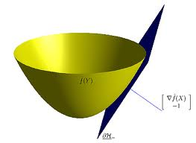
Convex functions
Convex functions look something like:
One definition: The line segment between any two points on the function is above the function

Slide 27
Surrogate loss functions
For many applications, we really would like to minimize the 0/1 loss
A surrogate loss function is a loss function that provides an upper bound on the actual loss function (in this case, 0/1)
We’d like to identify convex surrogate loss functions to make them easier to minimize
Key to a loss function is how it scores the difference between the actual label y and the predicted label y’

Slide 28
Surrogate loss functions
0/1 loss:
Ideas?
Some function that is a proxy for error, but is continuous and convex

Slide 29
Surrogate loss functions
0/1 loss:
Hinge:
Exponential:
Squared loss:
Why do these work? What do they penalize?

Slide 30
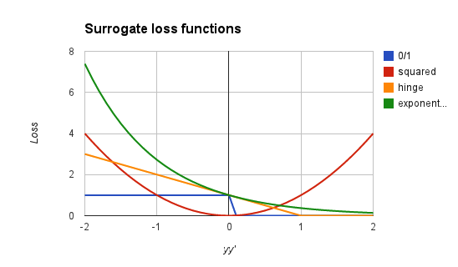
Surrogate loss functions
0/1 loss:
Hinge:
Squared loss:
Exponential:
Notes:
notice, all are convex
all (except hinge) are differentiable

Slide 31
Model-based machine learning
pick a model
pick a criteria to optimize (aka objective function)
develop a learning algorithm
use a convex surrogate loss function
Find w and b that minimize the surrogate loss

Slide 32


Finding the minimum
You’re blindfolded, but you can see out of the bottom of the blindfold to the ground right by your feet. I drop you off somewhere and tell you that you’re in a convex shaped valley and escape is at the bottom/minimum. How do you get out?

Slide 33
Finding the minimum
loss
w
How do we do this for a function?

Slide 34
One approach: gradient descent
Partial derivatives give us the slope (i.e. direction to move) in that dimension
loss
w

Slide 35
One approach: gradient descent
Partial derivatives give us the slope (i.e. direction to move) in that dimension
Approach:
pick a starting point (w)
repeat:
pick a dimension
move a small amount in that dimension towards decreasing loss (using the derivative)
loss
w

Slide 36
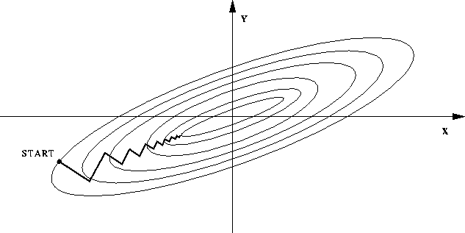
One approach: gradient descent
Partial derivatives give us the slope (i.e. direction to move) in that dimension
Approach:
pick a starting point (w)
repeat:
pick a dimension
move a small amount in that dimension towards decreasing loss (using the derivative)

Slide 37
Gradient descent
pick a starting point (w)
repeat until loss doesn’t decrease in all dimensions:
pick a dimension
move a small amount in that dimension towards decreasing loss (using the derivative)
What does this do?

Slide 38
Gradient descent
pick a starting point (w)
repeat until loss doesn’t decrease in all dimensions:
pick a dimension
move a small amount in that dimension towards decreasing loss (using the derivative)
learning rate (how much we want to move in the error direction, often this will change over time)

Slide 39
Some maths

Slide 40
Gradient descent
pick a starting point (w)
repeat until loss doesn’t decrease in all dimensions:
pick a dimension
move a small amount in that dimension towards decreasing loss (using the derivative)
What is this doing?

Slide 41
Exponential update rule
for each example x_{i}:
Does this look familiar?

Slide 42
Perceptron learning algorithm!
repeat until convergence (or for some # of iterations):
for each training example (f₁, f₂, …, f_{m}, label):
if prediction * label ≤ 0: // they don’t agree
for each w_{j}:
w_{j} = w_{j} + f_{j}*label
b = b + label
or
where

Slide 43
The constant
learning rate
label
prediction
When is this large/small?

Slide 44
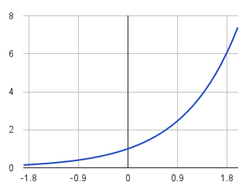
The constant
label
prediction
If they’re the same sign, as the predicted gets larger there update gets smaller
If they’re different, the more different they are, the bigger the update

Slide 45
One concern
loss
What is this calculated on?
Is this what we want to optimize?
w

Slide 46
Perceptron learning algorithm!
repeat until convergence (or for some # of iterations):
for each training example (f₁, f₂, …, f_{m}, label):
if prediction * label ≤ 0: // they don’t agree
for each w_{j}:
w_{j} = w_{j} + f_{j}*label
b = b + label
Note: for gradient descent, we always update
or
where

Slide 47
One concern
loss
We’re calculating this on the training set
We still need to be careful about overfitting!
The min w,b on the training set is generally NOT the min for the test set
w
How did we deal with this for the perceptron algorithm?

Slide 48
Summary
Model-based machine learning:
define a model, objective function (i.e. loss function), minimization algorithm
Gradient descent minimization algorithm
require that our loss function is convex
make small updates towards lower losses
Perceptron learning algorithm:
gradient descent
exponential loss function (modulo a learning rate)

Slide 49
CSE419 – Artificial Intelligence and Machine Learning 2018 PhD Furkan Gözükara, Toros University https://github.com/FurkanGozukara/CSE419_2018
Lecture 10/2
Regularization
Based on Asst. Prof. Dr. David Kauchak (Pomona College) Lecture Slides

Slide 50
Overfitting revisited: regularization
A regularizer is an additional criteria to the loss function to make sure that we don’t overfit
It’s called a regularizer since it tries to keep the parameters more normal/regular
It is a bias on the model forces the learning to prefer certain types of weights over others

Slide 51
Regularizers
Should we allow all possible weights?
Any preferences?
What makes for a “simpler” model for a linear model?

Slide 52
Regularizers
Generally, we don’t want huge weights
If weights are large, a small change in a feature can result in a large change in the prediction
Also gives too much weight to any one feature
Might also prefer weights of 0 for features that aren’t useful
How do we encourage small weights? or penalize large weights?

Slide 53
Regularizers
How do we encourage small weights? or penalize large weights?

Slide 54
Common regularizers
sum of the weights
sum of the squared weights
What’s the difference between these?

Slide 55
Common regularizers
sum of the weights
sum of the squared weights
Squared weights penalizes large values more
Sum of weights will penalize small values more

Slide 56
p-norm
sum of the weights (1-norm)
sum of the squared weights (2-norm)
p-norm
Smaller values of p (p < 2) encourage sparser vectors
Larger values of p discourage large weights more

Slide 57
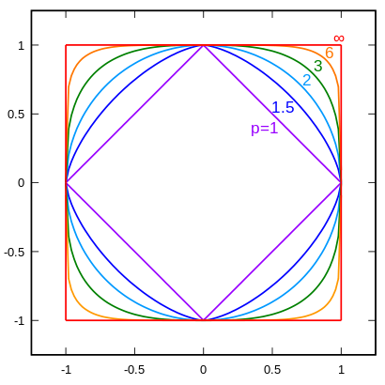
p-norms visualized
lines indicate penalty = 1
w₁
w₂
p | w₂
1 | 0.5
1.5 | 0.75
2 | 0.87
3 | 0.95
∞ | 1
For example, if w₁ = 0.5

Slide 58
p-norms visualized
all p-norms penalize larger weights
p < 2 tends to create sparse (i.e. lots of 0 weights)
p > 2 tends to like similar weights
Notes:
- The 1 norm penalizes non-zero weights, e.g

Slide 59

Model-based machine learning
pick a model
pick a criteria to optimize (aka objective function)
develop a learning algorithm
Find w and b that minimize

Slide 60
Minimizing with a regularizer
We know how to solve convex minimization problems using gradient descent:
If we can ensure that the loss + regularizer is convex then we could still use gradient descent:
make convex

Slide 61
Convexity revisited
One definition: The line segment between any two points on the function is above the function
Mathematically, f is convex if for all x₁, x₂:
the value of the function at some point between x₁ and x₂
the value at some point on the line segment between x₁ and x₂
Notes:
Put another way, the right hand side says, take the value of the function at x1, take the value of the function at x2 and then “linearly” average them based on t. This represents a line segment between f(x1) and f(x2)

Slide 62
Adding convex functions
Claim: If f and g are convex functions then so is the function z=f+g
Prove:
Mathematically, f is convex if for all x₁, x₂:

Slide 63
Adding convex functions
By definition of the sum of two functions:
Then, given that:
We know:
So:

Slide 64
Minimizing with a regularizer
We know how to solve convex minimization problems using gradient descent:
If we can ensure that the loss + regularizer is convex then we could still use gradient descent:
convex as long as both loss and regularizer are convex

Slide 65
p-norms are convex
p-norms are convex for p >= 1

Slide 66
Model-based machine learning
pick a model
pick a criteria to optimize (aka objective function)
develop a learning algorithm
Find w and b that minimize

Slide 67
Our optimization criterion
Loss function: penalizes examples where the prediction is different than the label
Regularizer: penalizes large weights
Key: this function is convex allowing us to use gradient descent

Slide 68
Gradient descent
pick a starting point (w)
repeat until loss doesn’t decrease in all dimensions:
pick a dimension
move a small amount in that dimension towards decreasing loss (using the derivative)

Slide 69
Some more maths
…
(some math happens)

Slide 70
Gradient descent
pick a starting point (w)
repeat until loss doesn’t decrease in all dimensions:
pick a dimension
move a small amount in that dimension towards decreasing loss (using the derivative)

Slide 71
The update
learning rate
direction to update
regularization
constant: how far from wrong
What effect does the regularizer have?

Slide 72
The update
learning rate
direction to update
regularization
constant: how far from wrong
If w_{j} is positive, reduces w_{j}
If w_{j} is negative, increases w_{j}
moves w_{j} towards 0

Slide 73
L1 regularization

Slide 74
L1 regularization
learning rate
direction to update
regularization
constant: how far from wrong
What effect does the regularizer have?

Slide 75
L1 regularization
learning rate
direction to update
regularization
constant: how far from wrong
If w_{j} is positive, reduces by a constant
If w_{j} is negative, increases by a constant
moves w_{j} towards 0
regardless of magnitude

Slide 76
Regularization with p-norms
L1:
L2:
Lp:
How do higher order norms affect the weights?
Notes:
if they’re magnitude > 1, reduce them drastically
if they’re magnitude < 1, much slower reductions for higher p

Slide 77
Regularizers summarized
L1 is popular because it tends to result in sparse solutions (i.e. lots of zero weights)
However, it is not differentiable, so it only works for gradient descent solvers
L2 is also popular because for some loss functions, it can be solved directly (no gradient descent required, though often iterative solvers still)
Lp is less popular since they don’t tend to shrink the weights enough

Slide 78
The other loss functions
Without regularization, the generic update is:
where
exponential
hinge loss
squared error

Slide 79
Many tools support these different combinations
Look at scikit learning package:
http://scikit-learn.org/stable/modules/sgd.html

Slide 80
Common names
(Ordinary) Least squares: squared loss
Ridge regression: squared loss with L2 regularization
Lasso regression: squared loss with L1 regularization
Elastic regression: squared loss with L1 AND L2 regularization
Logistic regression: logistic loss

